Slide 1


Slide 2
Introduction
Simple project which was similar to the Google Assistant in androids and Siri in IOS and Alaska in other softwares.
A Voice assistant is a user friendly guide to the users which it responds to the users command in a polite manner.
It is very useful to the modern generations as well as for further future too.

Slide 3
Libraries and Modules and their usage:
Pyttsx 3 :
pyttsx3 is a text-to-speech conversion library in Python.As it is used as a voice assistant to this project.
Datetime :
datetime module supplies classes to work with date and time. These classes provide a number of functions to deal with dates, times and time intervals.
Calendar :
calendar module allows output calendars like the program and provides additional useful functions related to the calendar.
Speech_Recognition :
speech_recognition module is used to recognise the command given by the user.
To recognize through microphone this module also needs another module to be install i.e (PyAudio) module.
PyAudio :
PyAudio is required if and only if you want to use
microphone input (Microphone).

Slide 4
Wikipedia :
Wikipedia is a Python library that makes it easy to access and parse data from Wikipedia.
WebBrowser :
The webbrowser module provides a basic interface to the system’s standard web browser. It provides an open function, which takes a filename or a URL, and displays it in the browser.
Os :
The OS module in python provides functions for interacting with the operating system. OS, comes under Python’s standard utility modules.
Smtplib :
smtplib module, which defines an SMTP client session object that can be used to send mail to any Internet machine with an SMTP or ESMTP listener daemon.

Slide 5
Wolframalpha :
Wolfram Alpha is a unique engine for computing answers and providing knowledge. It works by using its vast store of expert-level knowledge and algorithms to automatically answer questions, do analysis and generate reports.
Tkinter :
Tkinter is the standard GUI library for Python. Python when
combined with Tkinter provides a fast and easy way to create GUI
applications.
Pillow :
The Pillow library contains all the basic image processing functionality. You can do image resizing, rotation and transformation.

Slide 6
Time :
The Python time module provides many ways of representing time in code, such as objects, numbers, and strings.
SpeedTest :
speedtest-cli is a module that is used in the command-line interface for testing internet bandwidth using speedtest.net
Pywhatkit :
For playing youtube videos.

Slide 7
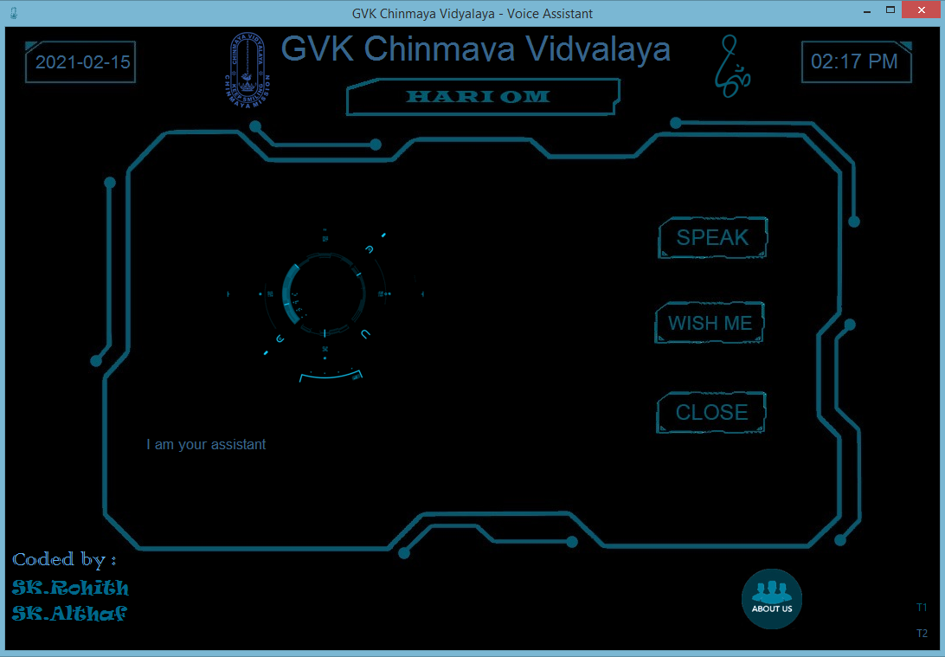
Output :

Slide 8
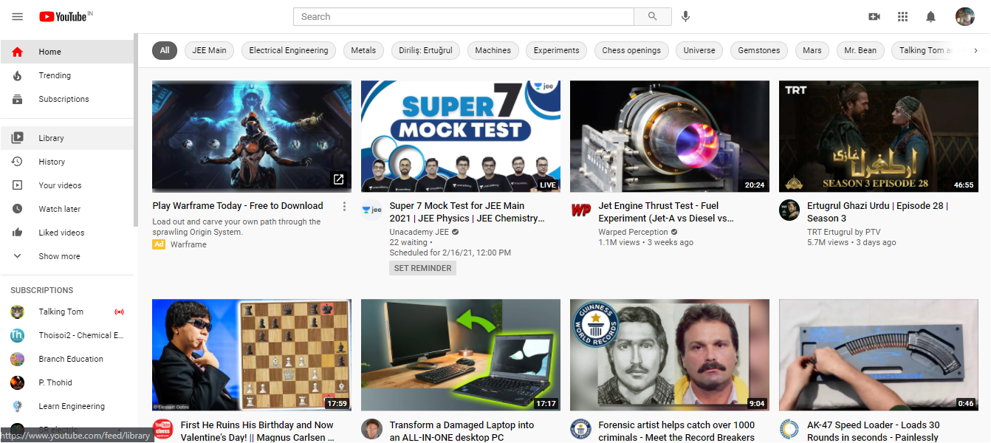

Slide 9
Done by:
Sk.Althaf
Sk.Rohith

